Slide 1
Device Driver
Topics :
Passing Arguments to Device Driver.
Major Number and Minor Number.
By: Harish Panicker

Slide 2
Passing Arguments to Device Driver
Module Parameters Macros
module_param(name,type,perm);
module_param_array(name,type,num,perm);
module_param_cb(name, ops, arg, perm);
There are several types of permissions:
S_IWUSR
S_IRUSR
S_IXUSR
S_IRGRP
S_IWGRP
S_IXGRP
In this S_I is a common header.
R = read ,W =write ,X= Execute.
USR =user ,GRP =Group
Using OR ‘|’ (or operation) we can set multiple permissions at a time.

Slide 3
Parameters may be passed to the modules during module
insertion
The macro “module_param (name, type, perm)” is used to
initialize the parameter at runtime.
It takes 3 arguments which are the parameter name,
parameter type and the permissions associated with the
parameter
This macro may be defined anywhere in the module

Slide 4
Major & Minor Numbers
Devices are referred to by names in the filesystem.
These names are called device files or simply nodes in the Filesystem.
They find their existence in the /dev directory of the filesystem.
They provide an interface to a device from the user space and is common to the kernel space to access the device too.

Slide 5
Major & Minor Numbers
On issuing an ls -al on the /dev directory, the following is listed
crw-rw---- 1 root uucp 33, 3 Mar 20 2005 cux3
crw-rw---- 1 root uucp 33, 4 Mar 20 2005 cux4
brw-r----- 1 root disk 12, 1 Mar 20 2005 dos_cd1
brw-rw----1 root disk 14, 0 Mar 20 2005 dos_hda
lrwxrwxrwx 1 root root 8 Oct 4 15:38 dmdsp0 -> /dev/dsp
‘c’ at the beginning of the file attributes specifies that the device is a character device.
‘b’ indicates that the device is a block device.
‘l’ indicates a link to a device file present at an other location.

Slide 6
Major & Minor Numbers
Major Number
  The major number identifies the driver associated with the device
  Multiple drivers may share major numbers
  For example, a major number may identify a driver for a hard disk
Minor Number
  Used by the kernel to determine exactly which device is being referred
  The minor numbers could serve as an index into a list of devices for the related driver
  For example, a minor number may be used to refer to one of the 4 hard disks present in the system
Both the major number and minor number together are called
Device Numbers

Slide 7
Device Numbers
Within the kernel, the dev_t type is used to hold device numbers.
dev_t is a 32 bit quantity with 12 bits set aside for the major number and 20
bits set aside for the minor number
To create a device number, use
dev_t MKDEV(int major, int minor)
To obtain the major and minor parts of a dev_t, macros come in handy
int MAJOR(dev_t dev)
int MINOR(dev_t dev)
Headers
#include <linux/kdev_t.h>
#include <linux/types.h>

Slide 8
Allocating Device Numbers in the Kernel
We can allocate the major and minor numbers in two ways.
Statically allocating
Dynamically Allocating
To Statically allocating a device number , we can use below function
– int register_chrdev_region (dev_t first, unsigned int count, char
*name);
To dynamically allocate a device number by the kernel, use
the function
– int alloc_chrdev_region (dev_t *dev, unsigned int firstminor,
unsigned int count, char *name);
– Returns 0 on successful allocation, Negative number if not
allocated

Slide 9
Allocating Device Numbers in the Kernel
Device numbers are freed with
void unregister_chrdev_region (dev_t first, unsigned int count)
Registering the device number in the init_module
Un-register the device number in the cleanup_module
Header
#include <linux/fs.h>

Slide 10
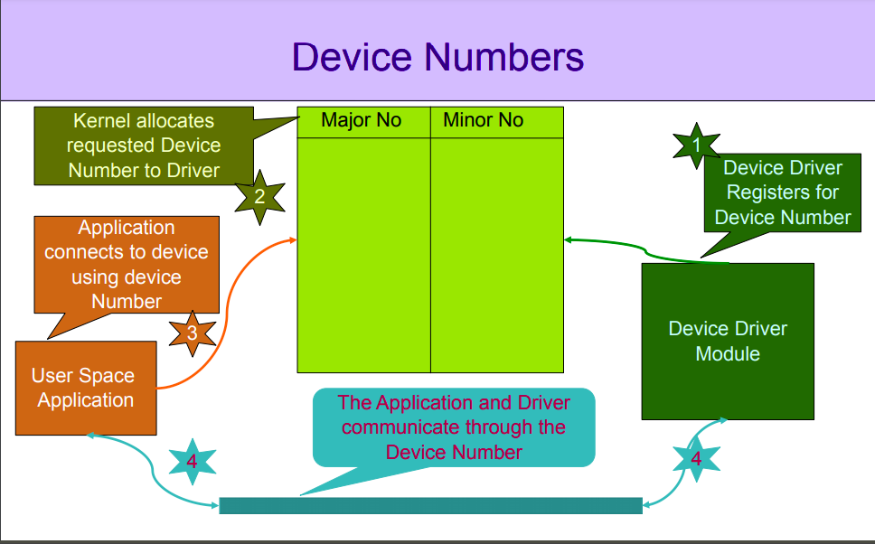

Slide 11
THANKS

